Slide 1
Shark Tank India Analysis

Slide 2
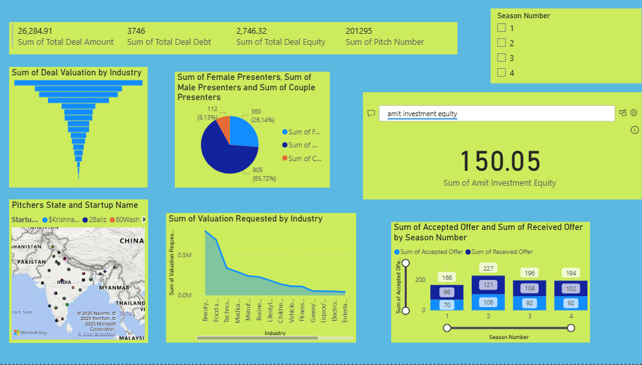
Shark Tank India Investment Dashboard
Season-wise & Industry-wise
Presented by-Khushali Chhatrala

Slide 3
Key Metrics Overview
Total Deal Amount: 26,284.91
Total Deal Debt: 3,746
Total Deal Equity: 2,746.32
Total Pitches Analyzed: 201,295

Slide 4
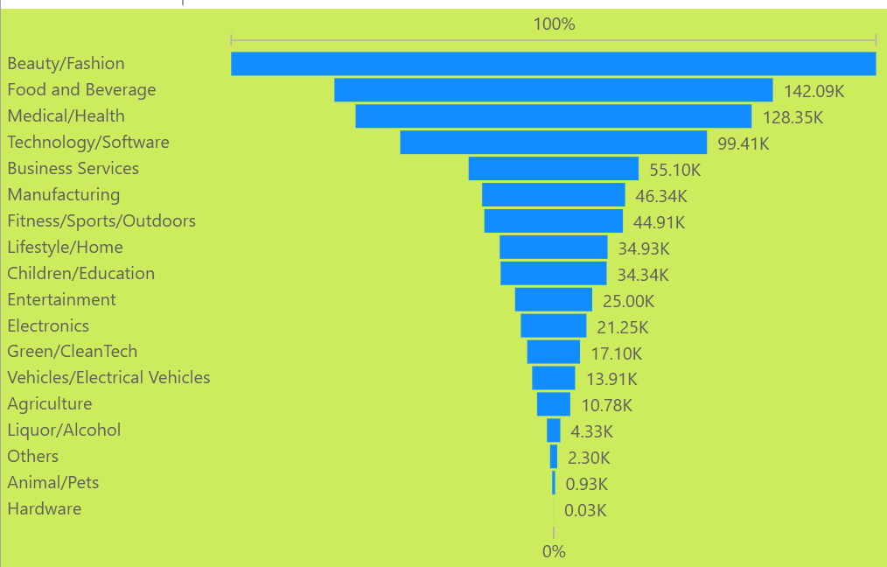
Industry-Wise Deal Valuation
Chart Type: Funnel Chart
Insight: The chart shows how the deal valuations vary across industries. The most significant deals are concentrated in top industries like Food & Beverage, Fashion, and Tech.

Slide 5
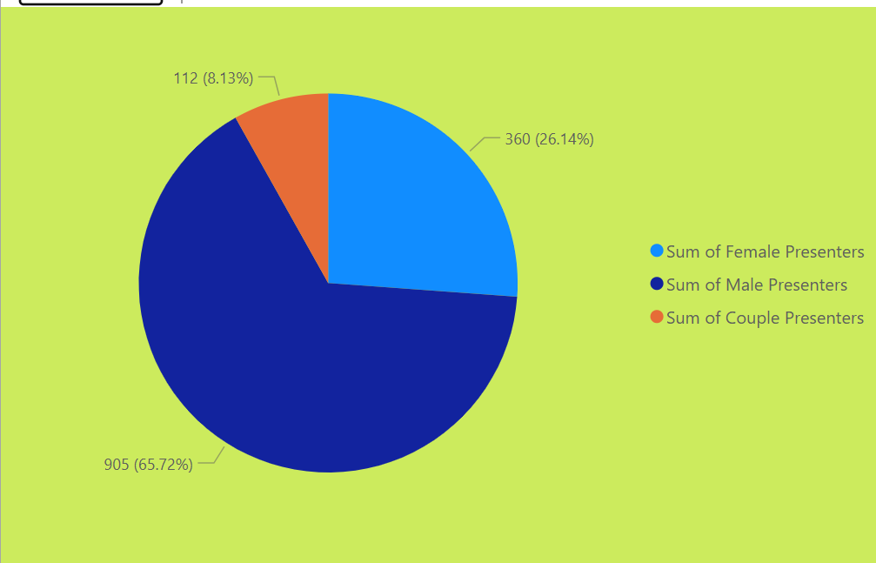
Presenter Demographics
Chart Type: Pie Chart
Insight:
Male Presenters: 65.72%
Female Presenters: 26.14%
Couple Presenters: 8.13%
Conclusion: Majority of pitches are by male founders; however, female and couple participation is notable.

Slide 6
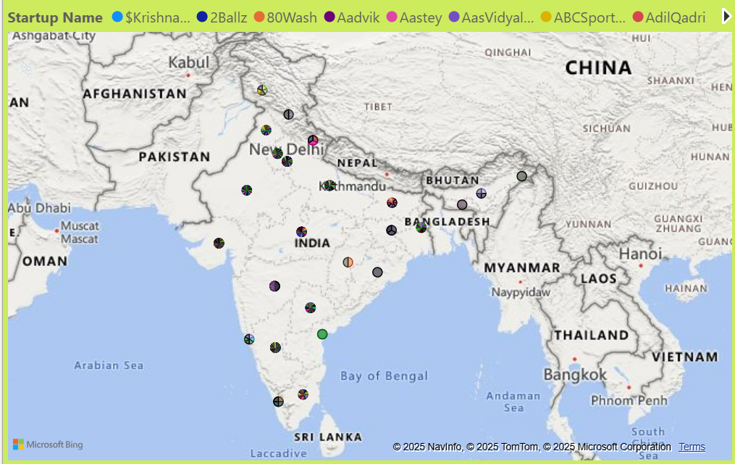
Geographic Distribution of Startups
Chart Type: Map Visualization
Insight: The map shows startup pitches from various regions in India, with concentration in major cities like Mumbai, Delhi, and Bangalore.

Slide 7
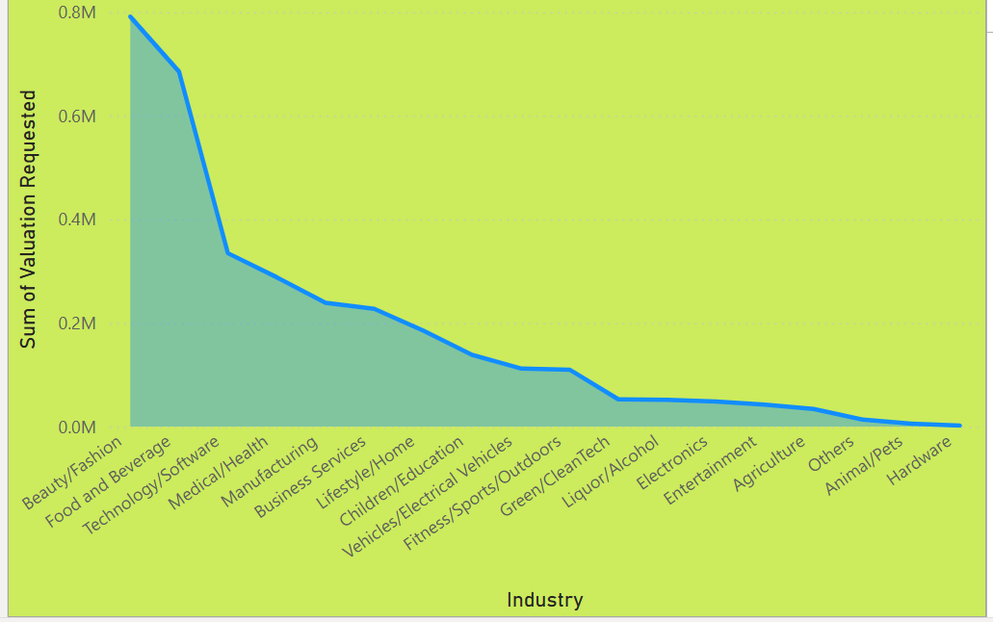
Valuation Requested by Industry
Chart Type: Line and Bar Combo Chart
Insight: Startups from industries like Beauty, Fashion, and Food & Beverage request higher valuations compared to niche sectors.

Slide 8
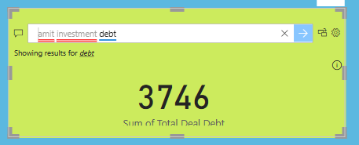
Investment by Individual Sharks
Insight:
Amit's Investment Equity: 150.05
This specific metric highlights Amit's total equity share across investments.
Amit’ total investment amount:1234.40
Amit’s investment debit:3746

Slide 9
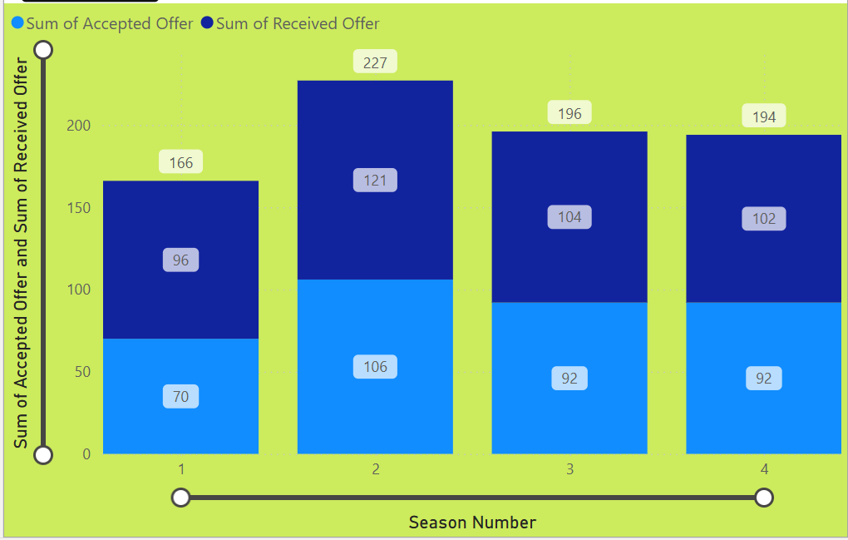
Deal Flow by Season
Chart Type: Clustered Bar Chart
Insight:
Season 1: 96 accepted out of 166 offers
Season 2: 121 accepted out of 227 offers
Season 3: 109 accepted out of 196 offers
Season 4: 92 accepted out of 194 offers
Conclusion: Deal conversion rate is consistent across seasons.

Slide 10
Conclusion & Recommendations
Shark Investment Patterns: Monitor active investors and deal sizes.
Founder Diversity: Encourage more female and couple-led startups.
Geographic Reach: Focus on expanding pitches from underrepresented regions.
Industry Trends: Track high-valuation sectors for future opportunities.

Slide 11
Thank You
Any Q & A

